Slide 1
Innovation Practice - Grassroot -
Technology Architecture
January 2020

Slide 2

Purpose
Inform the Developer Community of Practice of the Grassroot innovation program beyond the launch video.
Launch video regardez cette vidéo:

Slide 3
Innovation Practice – Background
IITB innovation framework was presented and approved at CIOEC.
The Grass root innovation program proposal presented herein is the first pillar of the framework

Slide 4
Grass Root Innovation Overview
Employees are offered the opportunity to do paid work on ideas to better the department regardless of the idea:
They meet basic criteria.
A specific number of hours is approved to work on the idea.
At the end of the period, they present the result of their work governance which decides to:
Stop working on the idea, transfer to operations, invest more research or scale to a large project.

Slide 5
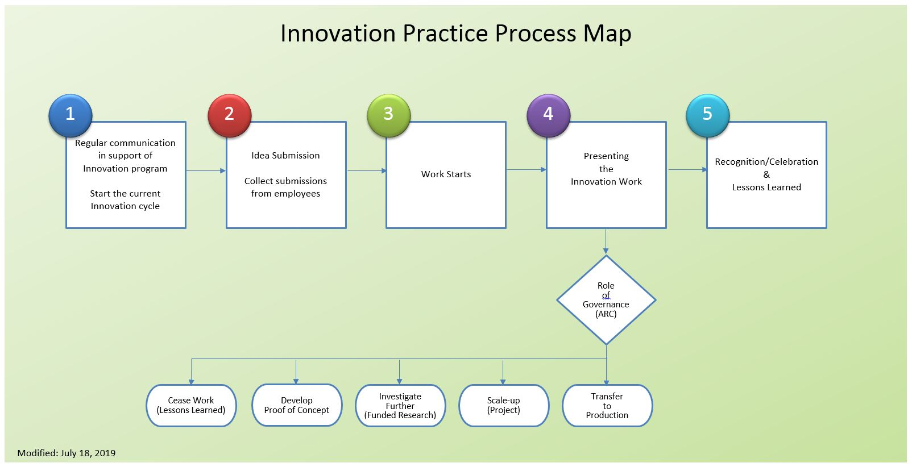
Grass Root Innovation Process

Slide 6
Process Steps
1
Regular communication in support of Innovation program – Start the current Innovation cycle
2
Idea Submission – Collect submissions from employees
3
Work Starts
4
Presenting the Innovation Work
5
Recognition/Celebration & Lessons Learned

Slide 7
Process Steps
1
Regular communication in support of Innovation program
Theme identified for current cycle
Tool & Technology | Finance
Security | Policies, Programs & Services
Administration | Regions
Integrity | Learning
HR | Office Environment
Communication
Employees requested to submit ideas/opportunities that address the theme with or without volunteering to do the work or consult the list of ideas to find one they want to work on.

Slide 8
Process Steps
2
Idea Submission
Employees submit their ideas on a continuous basis.
Employees confirms that:
Tools/technologies are available
External resources are not required.
Only IITB employees will be involved
All people involved in the idea must be able to meet the following criteria:
No overtime must be required to complete the innovation idea.
No impact on normal work/operations.
Capable of realizing the idea within 4 months.
Acceptance to produce a 15 minutes presentation on the work completed and the result.
Supervisor approval, Director denial
Notes:
If tools/technologies are not available, employees will have to follow the existing process to get approval for what they need to use (ITAM/OCMC). The practice will not be used for that.
Supervisor can only approve the work, but if the idea needs to be denied, it must be done by a Director.

Slide 9
Process Steps
3
Work starts
Employee starts working on the idea:
First come first serve
600 hours are allocated at any given time
Track time spent in CATS
The employee is informed of:
Total hours available to work on the idea
Expected date for presenting the results to governance (ARC)
Notes:
600 every 4 months, take 4 months for an idea to be brought to ARC
1800hrs/year which is .1% of hours available in IITB based on 1200 empl x 40 wks x 37.5hr/wk x .1%

Slide 10
Process Steps
4
Presenting the Innovation Work
Employee is invited to prepare a 15 mins presentation to ARC with the result of the innovation work.
ARC will make a determination of:
Transfer to production
Scale Up (elevate into a larger Project)
Investigate Further (Funded Research)
Develop Proof of Concept
Cease work
Notes:
EA will collaborate with the employee to support this portion of the process.

Slide 11
Process Steps
5
Recognition/Celebration & Lessons Learned
Recognition & Celebration:
Must be communicated and visibly supported by leadership within IITB (branch award, present at IITB showcase)
It is important this process be as transparent as possible to ensure buy-in from the Branch.
Change Management and Communications to be engaged to socialize Innovation activities:
Schedule Sponsor, Champion and participant activities
Socialize Monthly updates
Get Innovation activities mentioned in Blogs
Lessons Learned:
Post activity review to harvest:
Lessons learned
Unplanned take-aways
Notes:
Lessons learned used for continuous improvement and evolution of the practice based on needs of department and users’ feedback

Slide 12
Grassroot Innovation Program
Grassroot Innovation home

Slide 13
Resource Requirements
Employee
Business Line
EA Technology Architecture
Governance
Notes:
Employee: 1800hr/annually
BRM & Bus: Absorbed across all business lines
Tech Arch : 1 FTE to manage program and support employee; support, coordinate at ARC ( program by manager, ARC by Director)
Gov: Propose to leverage ARC as decision body as output of program
o Receives and accounts for the status of all ideas
o Answers questions regarding the Innovation Practice
o Maintains computerized records of the ideas/suggestions and generates reports on the activity of the program and project cost savings (if data is available and applicable).
o Provides statistics to Innovation management (Sponsor, Director, Manager)
o Maintains Innovation Practice program software
o Arranges for award ceremony when awards are given and related publicity
o Prepares brochures/Innovation Practice descriptions and promotes the Innovation Practice
o Providing guidance on the Innovation Practice and obtaining additional information from suggestor or affected Department; Branch/Unit
o Identifies and recommends changes in the Innovation Practice policy or administration as needed
o Handles all communications with suggestor concerning the Innovation Practice and their participation in it.

Slide 14

Questions ?

Slide 15
Key Lessons Learned from Past Innovation Programs
IIT - Ideas in Motion (2006 – eventual demise)
Generated ideas, but process to submit ideas was perceived as cumbersome.
Lacked a collaborative / crowd-sourcing component to help refine ideas.
IIT - Innovation Program (2011 – eventual demise)
Generated ideas, but lacked collaborative component from solution providers resulting in prolonged, if at all, execution times.
PASRB - Expose & Explain
Failed due to not being able to properly execute submitted ideas

Slide 16
IIT Launch: Crawl-Walk-Run
Crawl | Walk | Run
Launch with a small idea set | Expand idea set and quantity | Entire idea set available for consumption
Launch within a small segment of IIT (<300 users) Test single idea type and classification – Grassroots idea where the suggestor has the capability to evaluate and execute Enable capturing innovation stories (celebrate existing activities within IIT) Build the process through built-in tool automation to enable successful execution Establish Governance Establish a communications Plan - call out letter (twice a year) - routine for Sponsor, Champion and stakeholders engagement Produce basic reports based on statistics collected Build knowledge base Monitor and assess for continuous improvement | All of Crawl plus… Official LAUNCH event Expand to include ideas from all of IIT Keep to only Grassroots ideas but expand to include ideas that require additional resources to execute Introduce idea vetting process Introduce idea evaluation process Enable Innovation Review Board function Monitor and assess for continuous improvement | All of Walk plus… Establish connection with the PoC Enhanced statistics Monitor and assess for continuous improvement Update Project Plan Update Information Deck (SLF, CIOEX)
Ready to move to Walk when: The practice and process are functioning to acceptable standards Upon approval from management | Ready to move to Run when: The added complexity has been managed easily by the process and tool, management is satisfied with the results of this event. | Maturity check: Senior Management agrees the Practice has met all it’s goals and is ready for deployment beyond the Branch.
Will be developed based
On lessons learned
During Crawl Phase
May - August
Notes:
Crawl
A manual process is not suitable too (too resource intensive)
Governance prevents repeating Ideas that have been tried before but people submitting similar idea not knowing that it has failed. ... waste of time to continue
Getting Started, learning
Grassroots Idea
Criteria definition (Problem/Opportunity)
Input form using InfoPath
Innovation Tool is main Innovation repository (Planbox or SharePoint)
Blog / Forum capability
Report generation (extract only, no analysis)
Communications plan
Awareness of Practice (R&D)
Communiqué to capture Innovation through various initiatives/projects
Sponsorship
Management is aware and onboard
make staff aware of practice
Encourage involvement
Champion(s) – Kick-off, Ceremony Launch Preparation
Basic statistics (how the practice performs)
Identification of Integration with other Innovation Programs
Continuous improvements
Survey
(Accomplished via Comm plan)

Slide 17
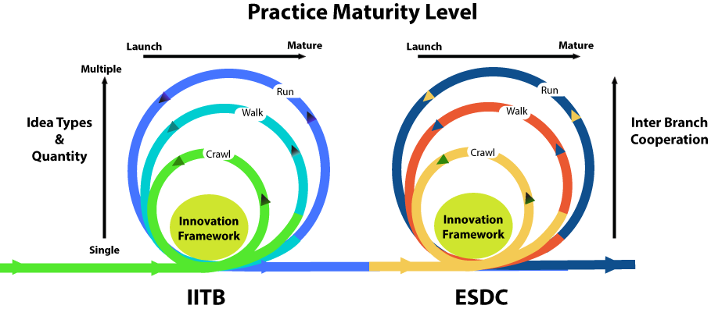
Longer Term : Crawl, Walk, Run
May - August
Notes:
Crawl, Walk, Run will be the approach for both IITB and ESDC deployments.
Both will include a “Continuous Improvement” component but the variables in” IITB – idea types, quantity, scope of invited participants
ESDC – idea types, quantity, scope of invited participants, inter branch cooperation, linking with existing Innovation concerns (labs, committees, etc)

Slide 18
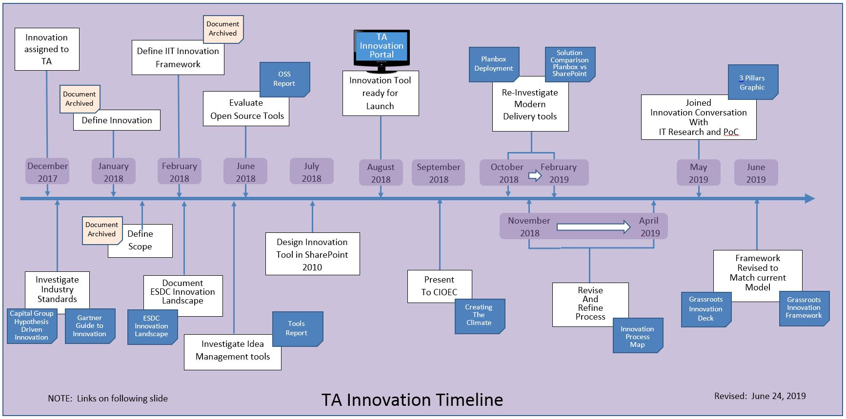
TA Innovation Time line

Slide 19
Links
Capital Group – Hypothesis Driven Innovation – Industry Report
Gartner Guide to Innovation – Industry Report
ESDC Innovation Landscape - Research Report
OSS Report - Research Report
Tools Report - Research Report
TA Innovation Portal – SharePoint Website
Creating the Climate - Presentation
Planbox Deployment - Research Report
Solution Comparison Planbox vs SharePoint – Options Analysis
Innovation Process Map - Graphic
3 Pillars Graphic - Graphic
Grassroots Innovation Deck - Presentation
Grassroots Innovation Framework – Administration Guide

Slide 20
Consultation
Cloud Executive Working Group
IIT Innovation Strategy Team
Technology Architecture (Innovation Practice – Grass Root): Franck Désormière / Alain Gauthier / Charles Ley
Information Technology Research: Simon Gascon / Patrice Lavoie
Branch Project Management Office (Proof Of Concept): Gilles Pilon / Theresa Champange
Curious IT: Mike Murphy / Calvin Rodo
ITSM workshops: Martin Mondor / Paul Lalonde
InfoTech Research Group

Slide 21
Process Steps
3
Triage/Assessment
Program owner (EA through BRM) will:
Facilitate meeting between employee and business line to validate the innovation aspect:
The idea adds value.
The idea has not been tried before.
The idea has been tried before but the idea tries to solve the problem it differently.

Slide 22
Process Steps
4
Idea Validation
Submission is accepted if :
Is within a category identified in the Call-Out Letter.
The employee(s) meets the eligibility criteria.
The idea has been validated with the appropriate business line.

Slide 23
Process Steps
6
Execution
Monitoring of progress and hours expended are tracked in CATS.
Work is perform as per conditions of eligibility and approval form.

Slide 24
Process Steps
8
Role of Governance
ARC will make a determination of:
Transfer to production
Scale Up (elevate into a larger Project)
Investigate Further (Funded Research)
Develop Proof of Concept
Cease work
9
7

